Slide 1
Are Carbon Emissions Associated With Stock Returns ?
(Review of Finance, 2023)
Jitendra Aswani
Harvard University
Aneesh Raghunandan
London School of Economics
Shivaram Rajgopal
Columbia University

Slide 2
Carbon Emissions and Stock Returns
Interest in the firm-level ESG disclosure - President Biden administration, SEC, Index Funds such as BlackRock, socially conscious investors, proxy advisors, and the media.
Is there any association between firm's carbon emissions and its stock return ?
  'Why ?' and 'Why should we observe such an association?’
  Emissions or measurement error.

Slide 3
Firm Size and Industry Effect
Stock returns are positively associated with (unscaled) carbon emissions. (Bolton and Kacperczyk, 2021)
Carbon emissions or equivalent are by-product of a industrial process and are directly proportional to quantity of raw materials (non-renewable resources or electricity or both) used. Therefore, emissions are likely related to the plant capacity and to the firm size.
Different industries have different level of emissions.

Slide 4
Firm emissions plotted on firm sales

Slide 5
Industry effects
Industry effect: High Emissions from Utility, Energy, Industrial, and Material Sectors.

Slide 6
Main Findings
There is no association between carbon emissions and stock returns (or with firm performance) after adjusting for the firm size, industry effect, and difference between estimated values (by the vendor) and actual disclosed values.
Increase in carbon pricing can change the situation. However, increase in pricing should be substantial.
Paris Agreement did not change this relation, at least in the short run (till 3 years).

Slide 7
Rethinking the Value and Emission Implications of Green Bonds
Jitendra Aswani
Harvard University
Shiva Rajgopal
Columbia Business School
4/15/2023

Slide 8
Overview
Motivation and Related Literature
Research Question(s) and Findings (in brief)
Data and Methodology
Results and Discussion
Conclusion

Slide 9
Motivation and Related Literature

Slide 10
Motivation
ESG Investing and Green Bonds
Boom in ESG investing in recent years.
Green bonds market till 2020 was > $1 Trillion, and governments and companies have decided to invest $ 500 Billion more in this asset class.
Institutions issuing green bonds - Corporate, SSA (Supranational, Sovereign, and Governmental), Municipal, Project, and ABS/MBS.
High proportion of corporate green bonds.

Slide 11
Motivation
“Green” in Green Bonds
Renewable energy - Solar, wind, hydro, and similar others.
Energy efficiency - Fuel cells, energy storage, electric vehicle, LED, and the like.
Green building and infrastructure - LEED certified buildings, energy efficient social infrastructure, and similar others.
Agriculture forestry - Reforestation, afforestation, land use, and the like.
Other sustainability - Climate change adaptation/mitigation, waste management, clean water, pollution control, and the like.

Slide 12
Motivation
Taste-based Hypothesis- Socially conscious investors are willing to trade wealth for societal benefits, which translates to a positive premium, or lower yields, for green securities.
  Pastor et al. (2021), Baker et al. 2018; Flammer 2021; Zhang and Tang, 2020; Zerbib, 2019.
Cost-based Hypothesis- ESG investing is costly due to requirement of third-party validation and limitation of proceeds to environmentally friendly projects. Therefore, green investing does not generate positive net present value (NPV) and leads to zero or negative premium.
  Larcker and Watts, 2020; Factica et al. 2020; Reed et al. 2017.

Slide 13
Motivation
Past Work
Tang and Zhang (2020)
  Positive market reaction to the issuance of corporate green bonds.
  No premium found, as shown by Larcker and Watts (2018) for muni green bonds
  Stock liquidity and domestic institutional ownership increases post-issuance.
Flammer (2021)
  Investors react positively to the announcement of green bond issuance, and the response is stronger for first-time issuers and bonds certified by third parties.
  Issuers improve their environmental performance post-issuance (i.e., higher environmental ratings and lower CO2 emissions), and experience an increase in ownership by long-term and green investors.

Slide 14
Motivation
Past Work (Contd.)
Pastor, Stambaugh, and Taylor (2022)
  Green assets delivered high returns in recent years due to unexpectedly strong increases in environmental concerns rather than high expected returns.
  Found ‘greenium’ in German green bonds over their higher-yielding non-green twins.
  U.S. green stocks outperformed brown as climate concerns strengthened. Nevertheless, they estimate lower expected returns for green stocks than for brown, consistent with Pastor, Stambaugh, and Taylor (2021).

Slide 15
Research Question(s) and Findings (in Brief)

Slide 16
Research Question(s)
Disentangling the stock market reaction to the announcement of green bonds: Focusing on micro-details such as the cross-sectional factors (bond, firm, and country characteristics).
Information asymmetry and secondary market of green bonds : Examine the risk characteristics, and the debt market returns of green bonds in the secondary market as periodic performance reports on green projects and the associated assurance of green auditors would reveal additional information and would thus be priced in the secondary market.
Environment performance of issuers: Investigate the environmental performance of issuers to understand their motive and impact of green bonds.
Revisiting investors preferences and issuer motives re: green bonds.

Slide 17
Findings
In Brief
Investor Preference : Stock Market Reaction
  Cumulative abnormal equity market return (CAR) over three days surrounding the bond issuance event for listed firms in the international sample from 2013–18 is positive and significant.
    CARs are much higher for the U.S. sample (0.943% and significant at the 5% level) compared with the international sample (0.015% and insignificant)
    From 2013-2018, Tesla’s green bonds account for the bulk of the positive equity market reaction to U.S. green bond issuances. The CAR associated with Tesla’s green bond issuance is 1.136% (significant at the 5% level), while that associated with the green bonds for the remainder of the U.S. sample is insignificant.
    A similar issuer clustering in this asset class is observed in other parts of global market.
    On analyzing the full sample (2013-2020) or separately examining the 2019-2020 sample, we find market reaction to be statistically insignificant.

Slide 18
Findings
In Brief
Investor Preference : Pricing in Secondary Market of Green Bonds
    Traded at a negative 31.8 bps (basis points) premium accumulated over one month.
    ‘Greenium’ due to financial sector and not due to polluting sectors of the economy (i.e., the utility, energy, material, and industrial segments)
    Surprisingly, the higher greeniums (green premium) should be expected in the polluting sectors given the investors’ desire to provide financing to these companies to improve their environmental impact.
Environment Performance
    Firms with high emissions, low ESG score, and no target emissions issue green bonds.
    Issuer’s emissions not reduces even after 4 years. This result is further robust for disclosed emissions compare to vendor-estimated emissions.

Slide 19
Data

Slide 20
Data
Bloomberg fixed income database - 3,483 Green bonds from 1st January 2013 to 31st December 2020.
Excluding bonds by supranational, government, and similar other agencies – 2,564 Green Bonds
The majority of the bonds is issued by firms headquartered in Sweden (340), followed by China (307), the U.S. (300), France (252), and Germany (227).
The firm characteristics and environment related variables are collected from WorldScope and Asset4 databases.

Slide 21
Data
(Contd.)
Issuer concentration in this asset class at the country level can potentially affect inferences associated with the stock market reaction to such issue. For instance, Vasakronan AB issued 29% of Sweden’s green bonds, Credit Agricole Corporate & Investment issued 59% of France’s green bonds, and similar clustered patterns are observed in other countries.
Of the 2,564 bonds in the sample, 1,961 were certified by the CBI or through a third-party ESG assurance provider. The Bloomberg database does not contain data on an assurance provider for 198 of the bonds.
Most of them have a maturity of 3, 5, 7, or 10 years.
75 % of bonds in the sample expires at maturity, and 25 % of bonds include options such as call, put, sink, and convertible.

Slide 22
Data
Bond-level Summary

Slide 23
Concentration of Green Bonds – Public Issuers

Slide 24
Concentration of Green Bonds (Cumulative) – Public Issuers

Slide 25
Methodology and Empirical Specification

Slide 26
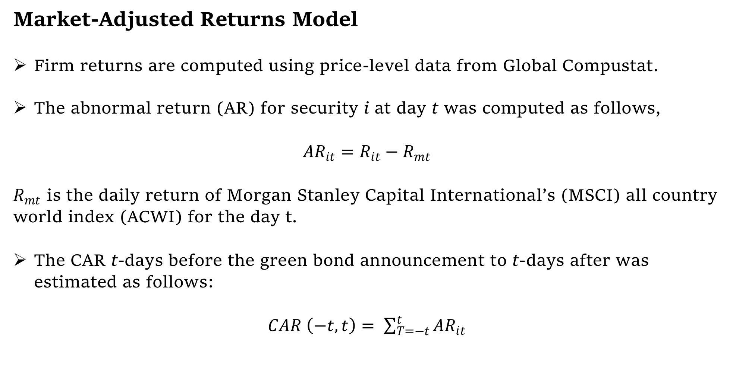
Methodology
Stock Market Reaction
Market-Adjusted Returns Model
Firm returns are computed using price-level data from Global Compustat.
The abnormal return (AR) for security i at day t was computed as follows,
$AR_{it}=R_{it}−R_{mt}$
$R_{mt}$ is the daily return of Morgan Stanley Capital International’s (MSCI) all country world index (ACWI) for the day t.
The CAR t-days before the green bond announcement to t-days after was estimated as follows:
$CAR \left(−t,t\right)= \sum_{T=−t}^{t}{AR_{it}}$

Slide 27
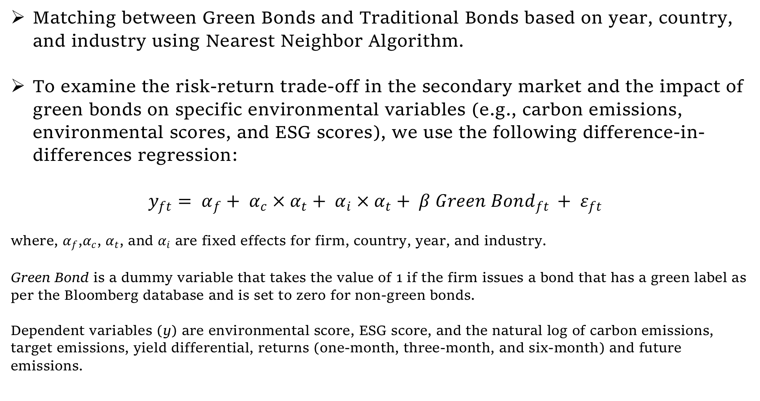
Methodology
Secondary Market Pricing and Environment Performance
Matching between Green Bonds and Traditional Bonds based on year, country, and industry using Nearest Neighbor Algorithm.
To examine the risk-return trade-off in the secondary market and the impact of green bonds on specific environmental variables (e.g., carbon emissions, environmental scores, and ESG scores), we use the following difference-in-differences regression:
$y_{ft}= α_{f}+ α_{c} × α_{t}+ α_{i} × α_{t}+ β Green Bond_{ft }+ ε_{ft}$
where, $α_{f}$,$α_{c}$, $α_{t}$, and $α_{i}$ are fixed effects for firm, country, year, and industry.
Green Bond is a dummy variable that takes the value of 1 if the firm issues a bond that has a green label as per the Bloomberg database and is set to zero for non-green bonds.
Dependent variables (y) are environmental score, ESG score, and the natural log of carbon emissions, target emissions, yield differential, returns (one-month, three-month, and six-month) and future emissions.

Slide 28
Results : Stock Market Reaction to Green Bonds Announcements

Slide 29
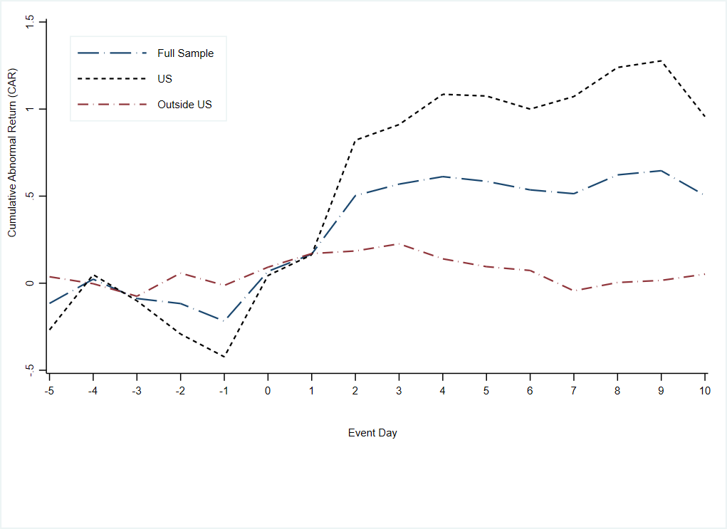
Results
Stock Market Reaction
Stock Market Reaction to Announcement of Green Bonds (measured as CARs)

Slide 30
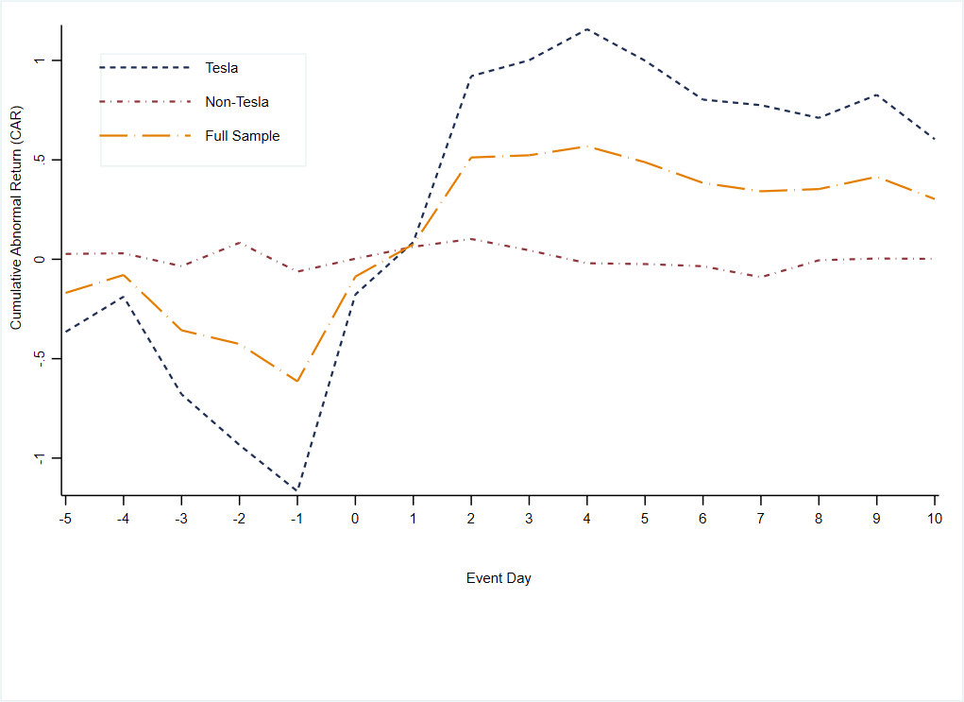
Results
Stock Market Reaction
Tesla vs. Others

Slide 31
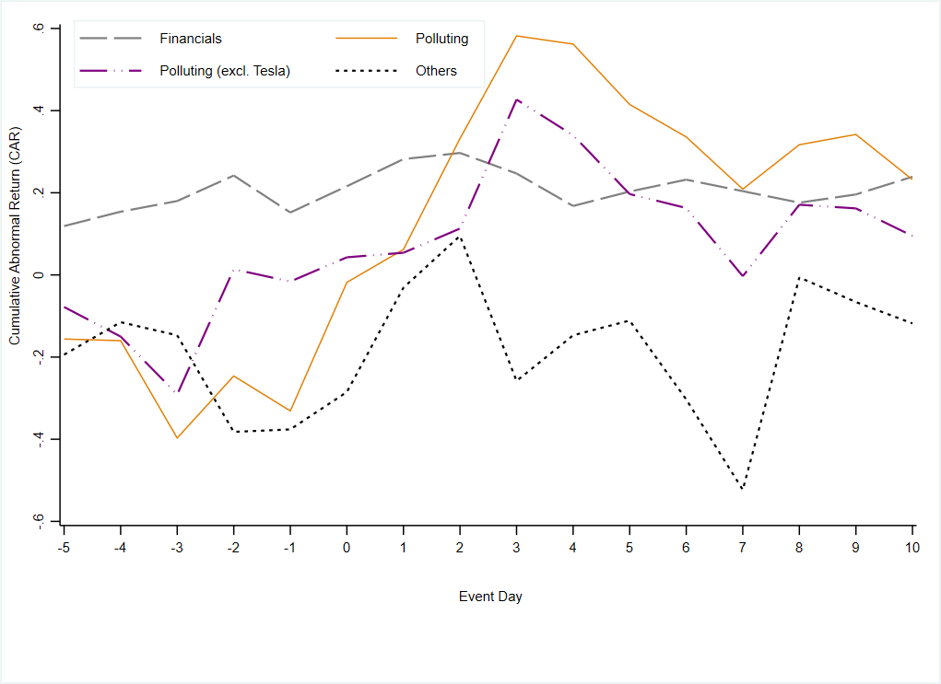
Results
Stock Market Reaction
Sector-Wide Reaction
Market reaction for green bonds by firms from:
  Financial Sector : +ve
  Polluting Sector (including Tesla): +ve
  Polluting Sector (excluding Tesla): Zero
  Other sectors: -ve

Slide 32
Results : Pricing of Green Bonds in the Secondary Market

Slide 33
Results
Secondary Market Risk-Return
Univariate Analysis
“Greenium” mainly for financial firms and not for polluters.
Odd?

Slide 34
Results
Secondary Market : Comparing Green Bonds vs Conventional Bonds

Slide 35
Results
Secondary Market : Comparing Green Bonds vs Conventional Bonds

Slide 36
Results
Secondary Market : Comparing Green Bonds vs Conventional Bonds

Slide 37
Results : Environmental Performance of Green Bond Issuers

Slide 38
Results
Environment Performance of Green Bond Issuers : Pre-Issuance
Run the regression on last year’s ESG score, Environment Score, and total emissions on green bond indicator.
Key Take-away: Firms with low ESG score, low environment score, and high emissions issue the green bonds.

Slide 39
Results
Environment Performance of Green Bond Issuers : Post-Issuance
Regression of 2-years and 4-years ahead total emissions and total reported (or disclosed) emissions on green bond indicator.
Key Take-away: No reduction in emissions even after 4 years.

Slide 40
Conclusion

Slide 41
Conclusion
Influential extant theory (e.g., Pastor et al. 2021) suggests that socially conscious investors are willing to trade wealth for societal benefits, which translates into a positive premium, or lower yields, for green securities.
Revisit the market pricing of green bonds in primary and secondary markets and examine the attendant environmental implications for both issuers and society.
Shareholders Reaction: U.S. green bonds dominate the overall market reaction and as U.S. green bond issuances are mainly driven by Tesla Inc., suggesting that such market reaction mostly captures a Tesla effect.
Secondary Market Pricing: Green bonds trade at a negative 23 basis premium in the secondary market, while this is mainly attributable to the green bonds of the financial sector rather than polluting (or brown ) sectors.
Environment Performance: Firms with weak environment performance issue green bonds with a commitment to improve. However, emissions didn’t improve even after 4 years. Situation is worse when only disclosed numbers rather than vendor-estimated emission numbers.

