Slide 1
The Tax-Smart Approach for Measuring and Maximizing After-Tax Performance
IAQF| November 17, 2021
Andrew Kalotay
Kalotay Advisors

Slide 2
Outline
How to measure after-tax performance
Tax-smart approach recommended
Liquidation value and hold value
Tax-loss harvesting
It’s an option, let’s treat it accordingly
Maximizing performance
Security selection
Restarting the short-term clock
Examples for municipal bonds
Why institutional investors prefer premium coupon munis

Slide 3
Calculation of After-Tax Performance
Current practice:
Return is based on pretax initial and terminal portfolio values
Interest and dividend payments are tax-adjusted
Pretax value is unsatisfactory
Because sale at indicated market prices is taxable
What’s the true value of your after-tax portfolio?

Slide 4
Recommendation: Use Tax-Smart Value
Tax-smart value = max (liquidation value, hold value)
Liquidation value = After-tax sale price
Tax depends on investor’s tax basis and holding period (long or short)
Hold value depends on horizon and terminal price
If bond matures prior to horizon date, its terminal value is par
Hold value is estimated from market price, but may differ from it

Slide 5
Why Sell?
Sale at a loss reduces taxes (known as tax-loss harvesting)
Tax basis: purchase price for stocks, amortized value for munis purchased at a premium
Tax rate depends on holding period
Short-term (less than 1 year) capital gains taxed at 40%
Long-term capital gains taxed at 20%
In order to recognize loss for tax purposes, need off-setting gain

Slide 6
Muni Candidates for Tax-Loss Harvesting November 2021
ISSUER | Price | COUPON |  | RATING | MATURITY
NORTH CAROLINA ST GRANT ANTIC VEH BDS 2019 | 125.02 | 5 |  | A+ | 2034-03-01
MASSACHUSETTS ST REF BDS 2018C | 131.88 | 5 |  | Aa1 | 2030-09-01
COLORADO SPRINGS COLO UTILS RE SYS REF BDS 2019 A | 130.16 | 5 |  | Aa2 | 2029-11-15
CONNECTICUT ST REVOLVING FD GE BDS 2019 A | 126.96 | 5 |  | Aaa | 2031-02-01
MINNEAPOLIS MINN SPL SCH DIST GO REF BDS 2021 A | 135.5 | 5 |  | Aa2 | 2032-02-01
HARRIS CNTY TEX TOLL RD REV FIRST LIEN REF BDS 2021 | 131.19 | 5 |  | AA | 2031-08-15
VIRGINIA COLLEGE BLDG AUTH VA BDS 2020 A | 125.06 | 5 |  | AA+ | 2028-02-01
CHARLOTTE N C ARPT REV INTL BDS 2021A | 125.98 | 5 |  | AA- | 2028-07-01
FOREST HILLS MICH PUB SCHS BLDG SITE GO UNLTD TAX B 2021 I | 122.43 | 4 |  | Aa2 | 2030-05-01
FORT WORTH TEX INDPT SCH DIST UNLTD TAX BLDG BDS 2020 | 130.01 | 5 |  | Aaa | 2030-02-15
ILLINOIS ST TOLL HWY AUTH TOLL SR REF BDS 2019 B | 128.27 | 5 |  | A1 | 2030-01-01
GREATER ORLANDO AVIATION AUTH AMT BDS 2019 A | 126.98 | 5 |  | AA- | 2029-10-01
SAN MATEO CALIF UN HIGH SCH DI ELECTION 2020 GO BDS B | 122.28 | 4 |  | Aaa | 2032-09-01
CALIFORNIA ST VARIOUS PURP GO BDS | 128.04 | 5 |  | AA | 2029-03-01
WISCONSIN ST GO BDS 2020 B | 128.24 | 5 |  | Aa1 | 2029-05-01
BELLEVUE WASH LTD TAX GO REF BDS 2020 A | 120.54 | 4 |  | Aaa | 2028-12-01
NEW YORK N Y GO BDS FISCAL | 130.02 | 5 |  | Aa2 | 2031-08-01
MASSACHUSETTS ST GO CONSOLIDATED LN BDS 2021 C | 131.88 | 5 |  | AA+ | 2030-09-01
BALTIMORE CNTY MD CONSOLIDATED PUB IMPT GO 2020 | 130.5 | 5 |  | Aaa | 2031-03-01

Slide 7
Muni Benchmark Curve Is for 5% NC-10 Bonds
AAA Municipal Yields*
Prices of 5% NC-10 Bonds
2.0
1.8
1.6
1.4
1.2
1.0
0.8
0.6
0.4
0.2
0.0
140
130
120
110
100
90
80
70
60
Yield
Price
0
5
10
15
Years to Maturity
20
25
30
1 3 5 7 9 11 13 15 17 19 21 23 25 27 29
Years to Maturity
*Municipal Market Advisors 5% 10 year par call as of July 6, 2021

Slide 8
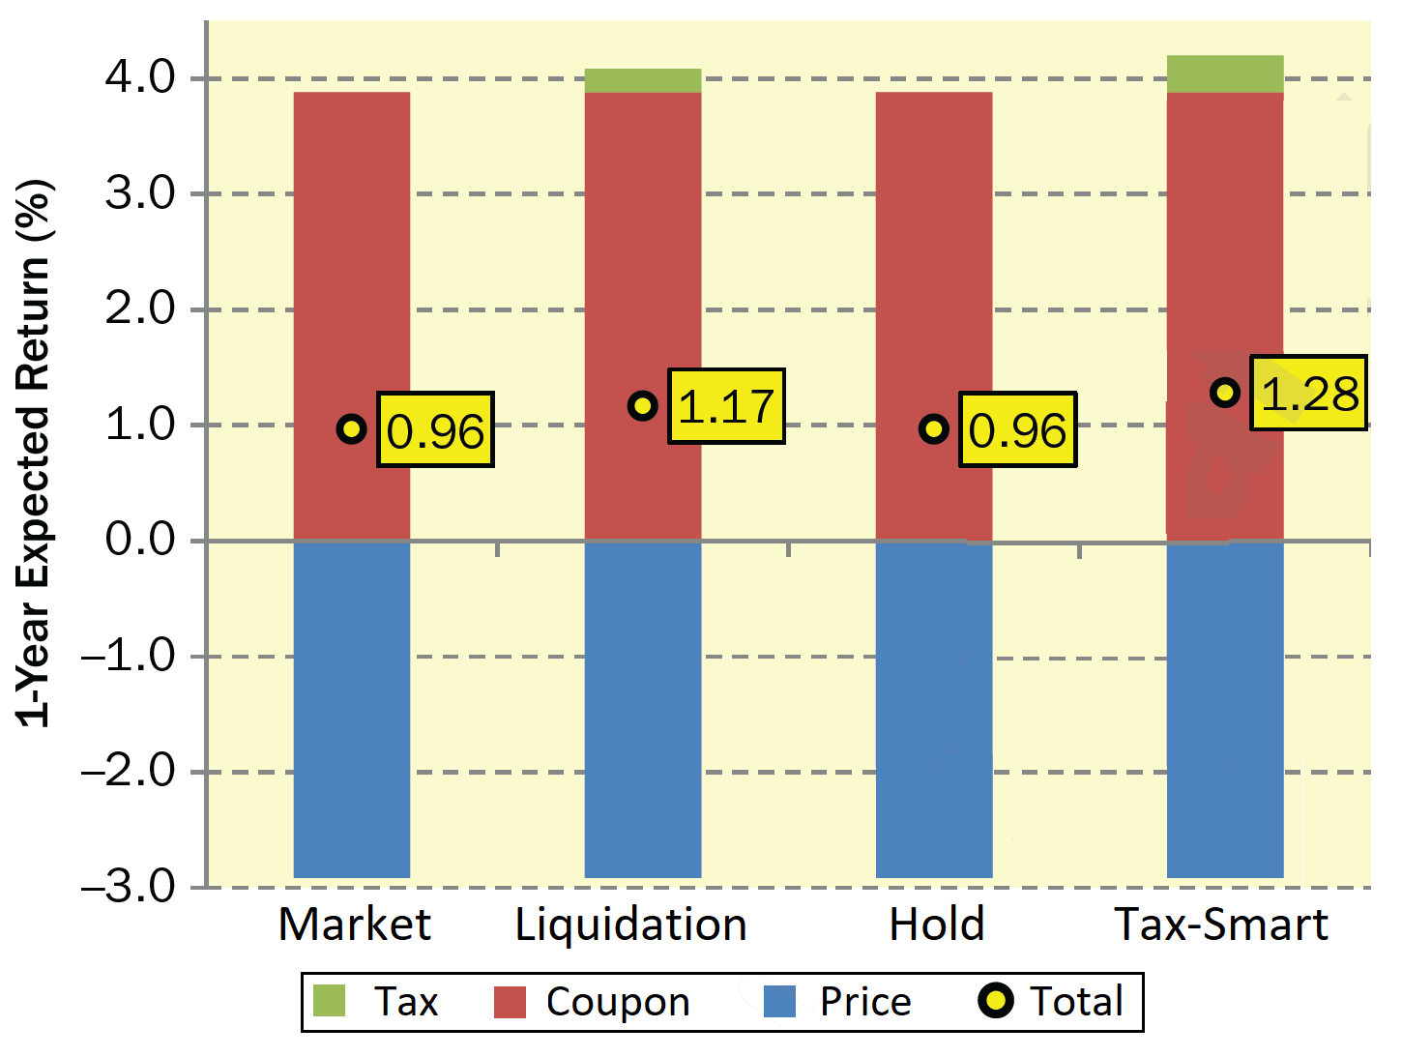
Expected Performance of 10-Year 5% Muni Purchased Today at 127.56, Upward-Sloping Yield Curve

Slide 9
More about Tax-Loss Harvesting
It is an option
Investor-specific, non-marketable
Acquired at purchase automatically and at no cost
Tax-rate arbitrage is another tax option for munis
Reinvestment of proceeds from tax-loss harvesting restarts short-term clock
Wash-sale rule does not apply to gains
Option exercise can be optimized
Depends on reinvestment policy
For munis, use standard fixed income analytics
Log-normal interest rate process, tax-neutral OAS analysis
Include (round trip) transaction cost

Slide 10
Tax Savings Don’t Guarantee Profitable Sale of Munis: De Minimis Tax Rule
Gain from purchase at a discount taxed at maturity:
Small (de minimis) gains taxed as capital gains; ~ 20%
Large gains taxed as ordinary income; ~ 40%
De minimis threshold: 100 minus (0.25 x years to maturity)
Market prices of discount munis reflect potential tax
Price is reduced by the present value of the tax
But current holder does not have such liability
Therefore hold value may exceed after-tax proceeds from sale

Slide 11
Market Value and Hold Value of ‘Par’ Bond Diverge As Interest Rates Rise
106
2% 10-Yr NCL Bond
104
102
Price (% par)
100
98
Hold value
Market value
96
94
92
-50
-40
-30
-20
-10
0
10
20
30
40
50
Change in Interest Rates (bps)

Slide 12
How to Accumulate Tax-Loss Harvesting Options
Purchase bonds selling at a premium
Bonds purchased near par are unsuitable for TLH, due to the de minimis effect
Restart the short-term clock
Short-term losses are worth twice as much as long-term losses
Consider sale/repurchase at a modest gain
Reduce transaction cost
Round trip may cost 1.5 points

Slide 13
Premium Munis Shine!
Par Bonds Expected to Significantly Underperform
1.2
1.0
0.8
0.6
10-year bonds
1-Year Expected Return (%)
1.50%
2.00%
5.00%
0.4
0.2
0.0
-0.2
10
20
30
Interest Rate Volatility (%)
40
50
13

Slide 14
Restarting the Short-Term Clock Can Improve Performance
5% 8-year bond purchased over a year ago Tax basis coincides with current price
Strategy ==> | Hold | Sell/Rebuy
Initial Value (Current Price) | 130.940 | 130.940
Tax Option Value (% par) | 1.665 | 2.285
Expected Ending Value | 126.717 | 126.986
Expected 1-Year Return (%) | 0.588 | 0.794

Slide 15
Restarting the Short-Term Clock at a Gain Sale Price Exceeds Tax Basis
5% 8-Year Bond Held for More Than 1 Year, Sold at 130.940
Tax-Smart Hold Returns (left axis)
Tax-Smart Sell/Rebuy Returns (left axis)
Tax Option Value w/o Reset (right axis)
Tax Option Value w/Reset Less Tax on Gain (right axis)

Slide 16
Practical Considerations in Tax-Loss Harvesting
Most suitable for Separately Managed Accounts
Mutual funds and ETFs not monitored on A/T performance
Reported performances are ambiguous and not widely available; rigorous definition of A/T performance would be desirable
For tax purposes, reported losses can’t exceed gains
Not for individually managed retail accounts
Retail prefers par bonds, which are unsuitable for TLH
Transaction cost of ‘round trip’ high
Lack required analytics

Slide 17
Summary
Calculate after-tax performance based on tax-smart values
Rather than mark-to-market
Treat tax-loss harvesting as an option
Monitor its value, exercise it optimally, consider transaction cost
Tax-smart return signals how to improve performance
Exercise TLH option prudently
Select securities strategically, consider restarting the short-term clock
Approach applicable to asset classes beyond munis
After-tax analysis is a fertile area for quantitative research
17

Slide 18
References
Option-Enhanced Tax-smart Value, Journal of Portfolio Management (April 2022, Forthcoming)
Tax-Smart Portfolio Valuation and Performance Measurement, Journal of Portfolio Management (August 2021)
Par Munis — Sub-Par Performance, The Journal of Fixed Income (Fall 2021)
Interest Rate Risk Management of Municipal Bonds, Andrew J Kalotay (Mar 5, 2021)
After-Tax Portfolio Value: The Missing Tax Option, Journal of Investment Management, (Vol. 14, No. 4, 2016)
Tax-Efficient Trading of Municipal Bonds, Financial Analysts Journal (Vol.72, No.1, 2016)
Optimal Municipal Bond Portfolios for Dynamic Tax Management Journal of Investment Management (Vol. 14, No. 1, 2016 )
Optimal Tax Management of Municipal Bonds, Journal of Portfolio Management (Fall 2014)
The Tax Option in Municipal Bonds, Journal of Portfolio Management (Winter 2014)
Interest Rate Sensitivity of Tax-Exempt Bonds Under Tax-Neutral Valuation
Journal of Investment Management (Vol. 12, No. 1, 2014)
Bond Analysis in Tax Denial, Tabb Forum, (March 2014)
18

